Slide 1

Go, change the world
RV College of
Engineering
4th and 5th Normal Forms

Slide 2

RV College of
Engineering
Presentation Contents
Properties of Lossless Join decomposition
Multivalued Dependencies and Fourth Normal Form
3. Join Dependencies and Fifth Normal Form

Slide 3
1. Properties of Relational Decompositions (1)
RV College of
Engineering
Relation Decomposition and Insufficiency of Normal Forms:
Universal Relation Schema:
A relation schema R = {A1, A2, …, An} that includes all the attributes of the database.
Universal relation assumption:
Every attribute name is unique.

Slide 4
Properties of Relational Decompositions (2)
Relation Decomposition and Insufficiency of Normal Forms (cont.):
Decomposition:
The process of decomposing the universal relation schema R into a set of relation schemas D = {R1,R2, …, Rm} that will become the relational database schema by using the functional dependencies.
Attribute preservation condition:
Each attribute in R will appear in at least one relation schema Ri in the decomposition so that no attributes are “lost”.

Slide 5
Properties of Relational Decompositions (2)
Another goal of decomposition is to have each individual relation Ri in the decomposition D be in BCNF or 3NF.
Additional properties of decomposition are needed to prevent from generating spurious tuples

Slide 6
Properties of Relational Decompositions (3)
RV College of
Engineering
Dependency Preservation Property of a Decomposition:
Definition: Given a set of dependencies F on R, the projection of F on R_{i}, denoted by p_{Ri}(F) where R_{i} is a subset of R, is the set of dependencies X  Y in F⁺ such that the attributes in X υ Y are all contained in R_{i}.
Hence, the projection of F on each relation schema R_{i} in the decomposition D is the set of functional dependencies in F⁺, the closure of F, such that all their left- and right-hand-side attributes are in R_{i}.

Slide 7
Properties of Relational Decompositions (4)
Dependency Preservation Property of a Decomposition (cont.):
Dependency Preservation Property:
A decomposition D = {R1, R2, ..., Rm} of R is dependency-preserving with respect to F if the union of the projections of F on each Ri in D is equivalent to F; that is ((π_{R1}(F)) υ . . . υ (π_{Rm}(F)))⁺ = F⁺
Claim 1:
It is always possible to find a dependency-preserving decomposition D with respect to F such that each relation Ri in D is in 3nf.

Slide 8
Properties of Relational Decompositions (5)
Lossless (Non-additive) Join Property of a Decomposition:
Definition: Lossless join property: a decomposition D = {R1, R2, ..., Rm} of R has the lossless (nonadditive) join property with respect to the set of dependencies F on R if, for every relation state r of R that satisfies F, the following holds, where * is the natural join of all the relations in D:
(π _{R1}(r), ..., π_{Rm}(r)) = r
Note: The word loss in lossless refers to loss of information, not to loss of tuples. In fact, for “loss of information” a better term is “addition of spurious information”

Slide 9
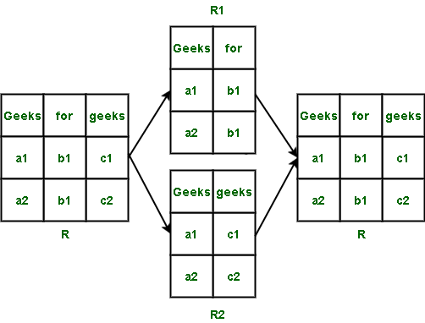
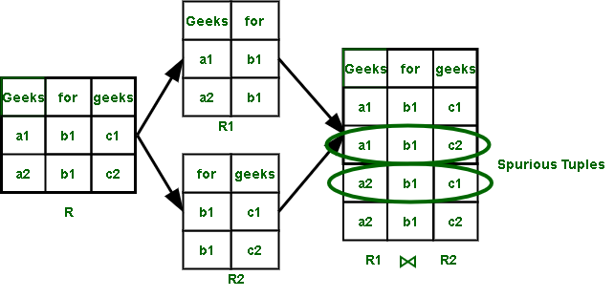
Spurious Tuples
RV College of
Engineering

Slide 10
Properties of Relational Decompositions (7)
RV College of
Engineering

Slide 12
RV College of
Engineering

Slide 13
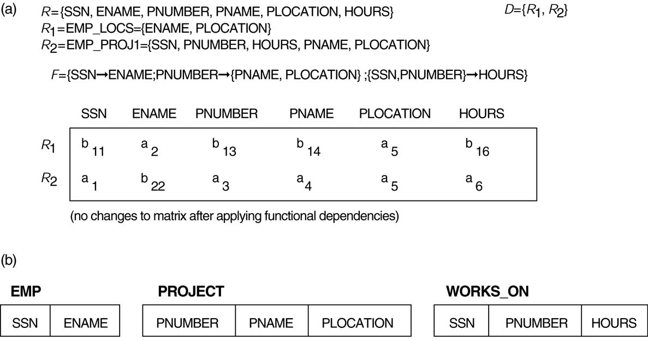
Properties of Relational Decompositions (8)
Lossless (nonadditive) join test for n-ary decompositions. (a) Case 1: Decomposition of EMP_PROJ into EMP_PROJ1 and EMP_LOCS fails test.
(b) A decomposition of EMP_PROJ that has the lossless join property.

Slide 14
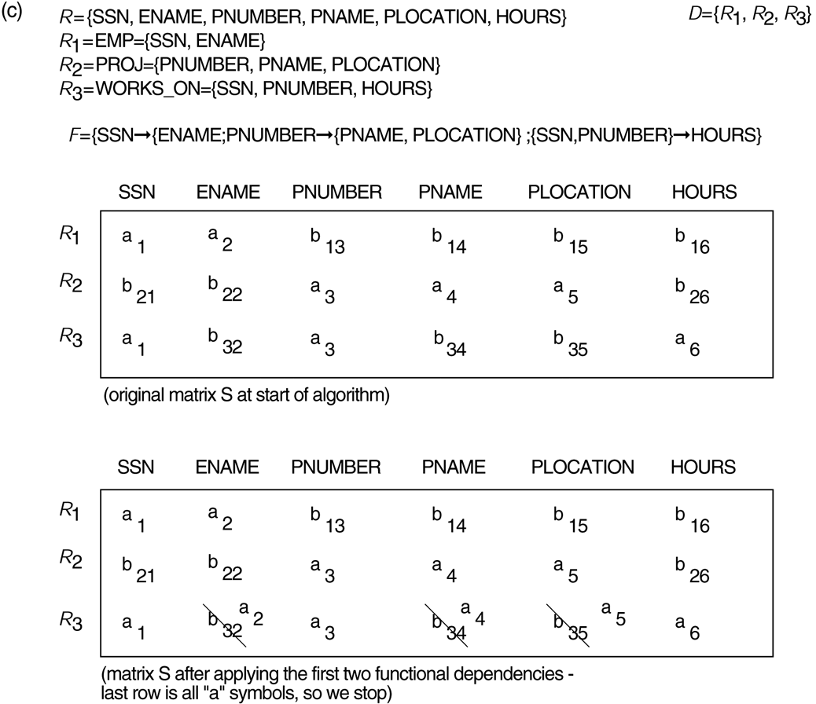
Properties of Relational Decompositions (8)
Lossless (nonadditive) join test for n-ary decompositions. (c) Case 2: Decomposition of EMP_PROJ into EMP, PROJECT, and WORKS_ON satisfies test.

Slide 15
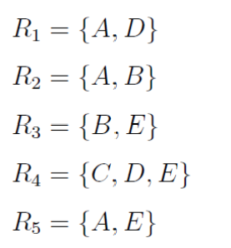
RV College of
Engineering

Slide 16
RV College of
Engineering

Slide 17
RV College of
Engineering

Slide 18
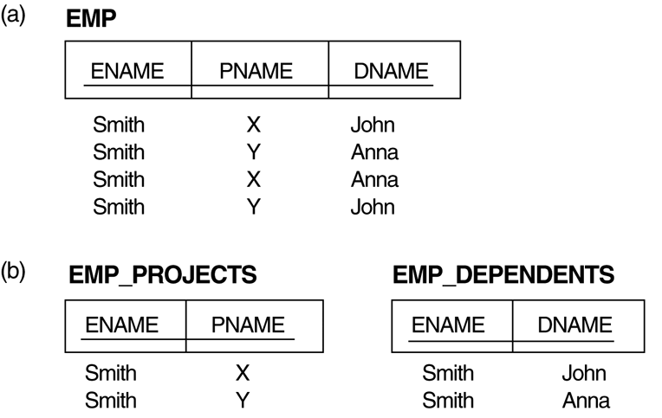
3. Multivalued Dependencies and Fourth Normal Form (1)
RV College of
Engineering
The EMP relation with two MVDs: ENAME —>> PNAME and ENAME —>> DNAME.
Decomposing the EMP relation into two 4NF relations EMP_PROJECTS and EMP_DEPENDENTS.

Slide 19
Multivalued Dependencies and Fourth Normal Form
RV College of
Engineering
Definition:
A multivalued dependency (MVD) X —>> Y specified on relation schema R, where X and Y are both subsets of R, specifies the following constraint on any relation state r of R: If two tuples t₁ and t₂ exist in r such that t₁[X] = t₂[X], then two tuples t₃ and t₄ should also exist in r with the following properties, where we use Z to denote (R 2 (X υ Y)):
t₃[X] = t₄[X] = t₁[X] = t₂[X].
t₃[Y] = t₁[Y] and t₄[Y] = t₂[Y].
t₃[Z] = t₂[Z] and t₄[Z] = t₁[Z].
An MVD X —>> Y in R is called a trivial MVD if (a) Y is a subset of X, or (b) X υ Y = R.

Slide 20
RV College of
Engineering
4th Normal Form
STUDENT | HOBBY | LANGUAGE
1 | Cricket | English
1 | Poetry | Urdu
2 | Cricket | Hindi
2 | Poetry | English
The database must satisfy the following two things
The database must meet all the requirement of 3NF, BCNF
There should be no more than one multi-valued dependencies.
According to the 4th normal form, a record type should not contain two or more independent multi-valued facts about an entity.
The table is Not in 4th Normal Form
Table: The Student table with more than one multi-valued dependency. (For example, one student can have many hobbies and similarly one student can have many languages.)
Instead, they should be represented in the two records
STUDENT | LANGUAGE
1 | English
1 | Urdu
2 | Hindi
STUDENT | HOBBY
1 | Cricket
1 | Poetry
2 | Singing

Slide 21
4. Join Dependencies and Fifth Normal Form
RV College of
Engineering
Definition:
A join dependency (JD), denoted by JD(R₁, R₂, ..., R_{n}), specified on relation schema R, specifies a constraint on the states r of R.
The constraint states that every legal state r of R should have a non-additive join decomposition into R₁, R₂, ..., R_{n}; that is, for every such r we have
* (π_{R1}(r), π_{R2}(r), ..., π_{Rn}(r)) = r
Note: an MVD is a special case of a JD where n = 2.
A join dependency JD(R₁, R₂, ..., R_{n}), specified on relation schema R, is a trivial JD if one of the relation schemas R_{i} in JD(R₁, R₂, ..., R_{n}) is equal to R.

Slide 22
Join Dependencies and Fifth Normal Form (2)
RV College of
Engineering
Definition:
A relation schema R is in fifth normal form (5NF) (or Project-Join Normal Form (PJNF)) with respect to a set F of functional, multivalued, and join dependencies if,
for every nontrivial join dependency JD(R₁, R₂, ..., R_{n}) in F⁺ (that is, implied by F),
every R_{i} is a superkey of R.

Slide 23
RV College of
Engineering
Join Dependency
If a table can be recreated by joining multiple tables and each of this table have a subset of the attributes of the table, then the table is in Join Dependency. It is a generalization of Multivalued Dependency
Join Dependency can be related to 5NF, wherein a relation is in 5NF, only if it is already in 4NF and it cannot be decomposed further.
<Employee>
<EmployeeSkills>
<EmployeeJob>
<JobSkills>
EmpName | EmpSkills | EmpJob (Assigned Work)
Tom | Networking | EJ001
Harry | Web Development | EJ002
Katie | Programming | EJ002
EmpSkills | EmpJob
Networking | EJ001
Web Development | EJ002
Programming | EJ002
EmpName | EmpSkills
Tom | Networking
Harry | Web Development
Katie | Programming
EmpName | EmpJob
Tom | EJ001
Harry | EJ002
Katie | EJ002
Join Dependency {(EmpName, EmpSkills ), ( EmpName, EmpJob), (EmpSkills, EmpJob)}

Slide 24
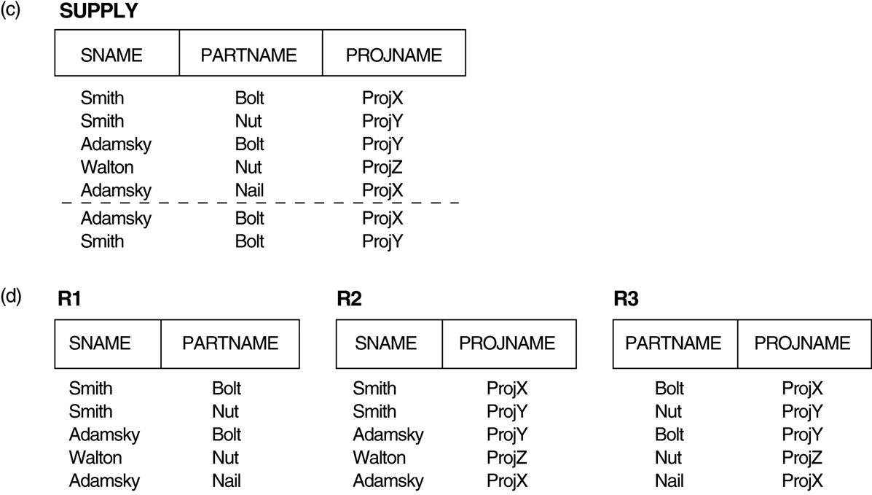
3. Multivalued Dependencies and Fourth Normal Form (1)
RV College of
Engineering
(c) The relation SUPPLY with no MVDs is in 4NF but not in 5NF if it has the JD(R1, R2, R3). (d) Decomposing the relation SUPPLY into the 5NF relations R1, R2, and R3.

Slide 25
RV College of
Engineering
Joint dependency
Join decomposition is a further generalization of Multivalued dependencies.
If the join of R1 and R2 over C is equal to relation R then we can say that a join dependency (JD) exists, where R1 and R2 are the decomposition R1(A, B, C) and R2(C, D) of a given relations R (A, B, C, D).
Alternatively, R1 and R2 are a lossless decomposition of R. A JD ⋈ {R1, R2, …, Rn} is said to hold over a relation R if R1, R2, ….., Rn is a lossless-join decomposition.
The *(A, B, C, D), (C, D) will be a JD of R if the join of join’s attribute is equal to the relation R. Here, *(R1, R2, R3) is used to indicate that relation R1, R2, R3 and so on are a JD of R.
Let R is a relation schema R1, R2, R3……..Rn be the decomposition of R. r( R ) is said to satisfy join dependency if and only if

Slide 26
Example – Consider the above schema, with a case as “if a company makes a product and an agent is an agent for that company, then he always sells that product for the company”. Under these circumstances, the ACP table is shown as:
Table – ACP
AGENT | COMPANY | PRODUCT
A1 | PQR | Nut
A1 | PQR | Bolt
A1 | XYZ | Nut
A1 | XYZ | Bolt
A2 | PQR | Nut
Table – R2
Table – R3
Table – R1
AGENT | COMPANY
A1 | PQR
A1 | XYZ
A2 | PQR
AGENT | PRODUCT
A1 | Nut
A1 | Bolt
A2 | Nut
COMPANY | PRODUCT
PQR | Nut
PQR | Bolt
XYZ | Nut
XYZ | Bolt
Result of Natural Join of R1 and R3 over ‘Company’ and then Natural Join of R13 and R2 over ‘Agent’and ‘Product’ will be table ACP.
Hence, in this example, all the redundancies are eliminated, and the decomposition of ACP is a lossless join decomposition. Therefore, the relation is in 5NF as it does not violate the property of lossless join.

